Slide 1



How To Manage People?
GÖRKEM KAYA - 211015002
TOTAL QUALITY MANAGEMENT

Slide 2

Contents
What managers do
Leadership
Motivating people
Organizing
Team building
Delegating
Selection interviewing
Managing performance
Helping people to learn and develop
Rewarding people
Managing change
Handling people problems
Table of Contents
TOTAL QUALITY MANAGEMENT

Slide 3
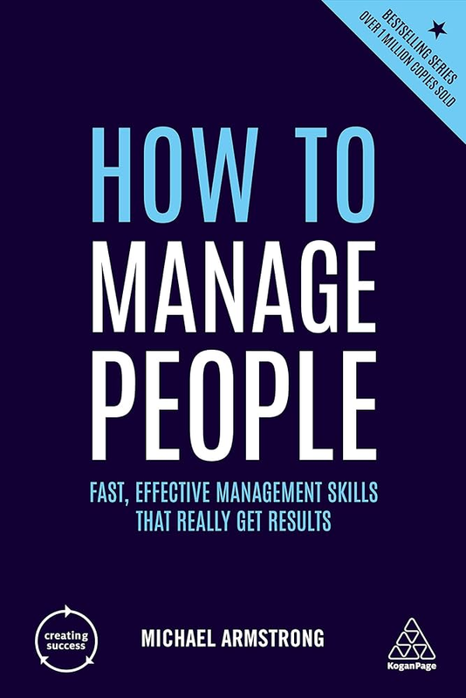

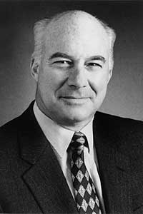

Michael Armstrong
Michael Armstrong is the UK's bestselling author of Human Resource Management books including Armstrong's Handbook of Human Resource Management Practice, Armstrong's Handbook of Strategic Human Resource Management, Armstrong's Handbook of Reward Management Practice and Armstrong's Handbook of Performance Management and several other titles published by Kogan Page. His books have sold over a million copies and have been translated into twenty-one languages.
www.reallygreatsite.com

Slide 4
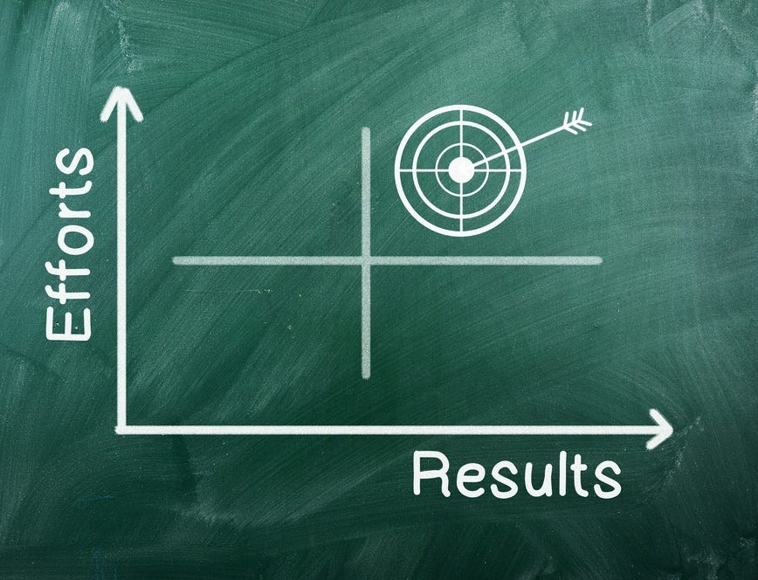
1. Focus on Results, Not Control
Guide employees: Instead of micromanaging processes, focus on outcomes and empower employees to take responsibility.
Build trust: Giving employees freedom fosters trust, which increases motivation.
Measure results: Track outcomes, not processes, and evaluate performance based on the results.
Grant initiative: Allow employees the freedom to make their own decisions and provide flexibility.
Example: Instead of checking every line of code written by a developer, focus on the project being delivered on time and without errors.
TOTAL QUALITY MANAGEMENT

Slide 5
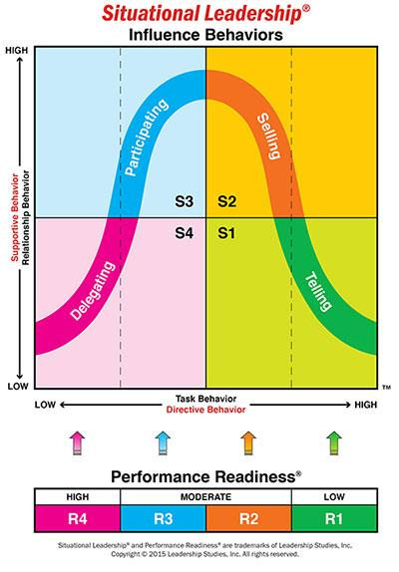
2)Adapt Your Management Style to the Individual
Understand individual needs: Each employee has unique strengths, weaknesses, and needs. Tailor your approach accordingly.
Flexibility based on experience: Offer more guidance to new employees while granting more freedom to experienced ones.
Personalized feedback: Tailor feedback to individual development levels.
TOTAL QUALITY MANAGEMENT

Slide 6

3. Clearly Define Expectations
Clarity: Clearly define roles, goals, and success criteria to avoid ambiguity.
Avoid uncertainty: Uncertainty leads to stress and mistakes. Be clear about what is expected.
Goal-oriented approach: Employees are more motivated when they have clear and specific goals to work toward.
Provide deadlines: Clearly state when goals need to be achieved to help employees manage their time effectively.
Example: Instead of saying “Prepare a presentation,” say “Prepare a 10-slide presentation with graphics by Monday, lasting 15 minutes” to set clear expectations.
TOTAL QUALITY MANAGEMENT

Slide 7

4. Provide Regular and Constructive Feedback
Real-time feedback: Offer feedback regularly, not just at the end of the year, so employees can improve continuously.
Positive and constructive: Feedback should not only be about criticism but also an opportunity for development.
Balanced communication: Provide both praise and constructive feedback to encourage growth and motivation.
Development-focused: Use feedback as a tool for personal development.
Example: Provide balanced feedback like “Your presentation was clear, but you could make the graphics more explanatory” to help employees grow.
TOTAL QUALITY MANAGEMENT

Slide 8
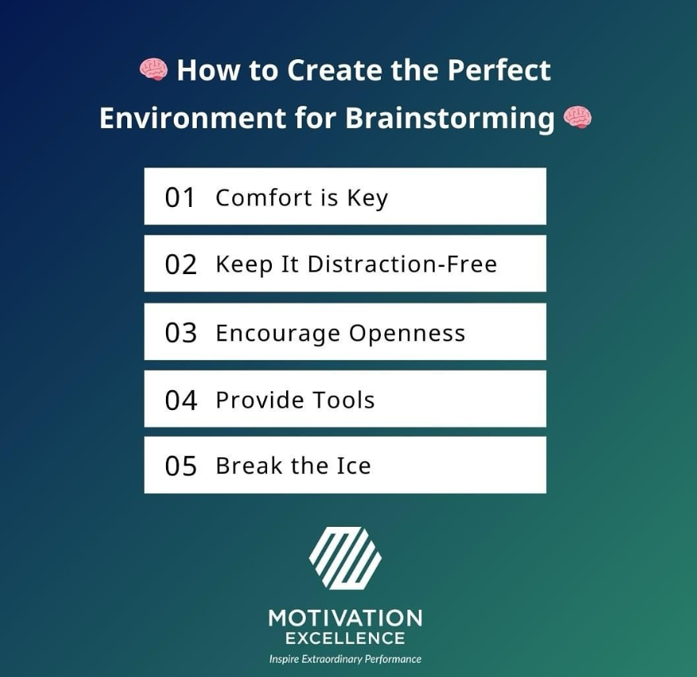
5. Create an Environment for Excellence
Provide the necessary tools: Ensure employees have the tools, time, and support they need to succeed.
Motivation: A motivating environment leads to higher performance and satisfaction.
Equipment and training: Provide the right software, hardware, and training for employees to perform their jobs well.
Psychological safety: Create an environment where employees feel comfortable taking risks and making mistakes.
Example: Providing a high-performance computer and the right software for a graphic designer enables them to do their best work.
TOTAL QUALITY MANAGEMENT

Slide 9

6. Don’t Avoid Difficult Conversations
Direct approach: Address difficult issues head-on, rather than avoiding or delaying them.
Open and respectful communication: Approach challenging topics with openness, honesty, and respect.
Resolve issues early: Address conflicts and issues at an early stage to prevent them from escalating.
Offer solutions: Difficult conversations should include proposed solutions, not just criticism.
Example: Have a one-on-one conversation with an underperforming employee early on and discuss expectations clearly and respectfully.
TOTAL QUALITY MANAGEMENT

Slide 10

7. Let Your Team Be the Hero, Not You
Share success: Celebrate team achievements, not just your own, to build stronger connections.
Highlight the team: Emphasize the contributions of your team when sharing success with others.
Build commitment: Leaders who focus on team success create a culture of collaboration and trust.
Create a culture: Celebrate teamwork and shared goals to reinforce a sense of collective accomplishment.
Example: When sharing project success with upper management, highlight the contributions of team members.
TOTAL QUALITY MANAGEMENT

Slide 11

8. Management is a Learned Skill
Continuous learning: Leadership is not innate; it is a skill that can be learned and developed.
Mentoring and feedback: Regularly seek mentorship or feedback to improve your management skills.
Reading and research: Enhance your leadership abilities by reading books or taking courses on leadership.
Practice makes perfect: Management skills are best developed through continuous practice and application.
Example: Read a leadership book or seek mentorship weekly to improve your management abilities.
TOTAL QUALITY MANAGEMENT

Slide 12

9. Hire the Right People, Don’t Try to Fix Later
Correct hiring: The foundation of good management starts with hiring the right people for the right roles.
Fit with team culture: Ensure that candidates have the right technical and social skills for the position.
Job description alignment: Make sure the candidate fits the job description to avoid issues later on.
Thorough interview process: Evaluate both technical and cultural fit during the hiring process.
Example: Hiring someone with strong technical skills but poor teamwork ability for a leadership role can lead to problems.
TOTAL QUALITY MANAGEMENT

Slide 13

10. Make Fewer Decisions, Delegate More
Delegation of authority: Empower your employees to make decisions, which will speed up the process and increase engagement.
Faster decision-making: Allowing employees to take responsibility for decisions accelerates progress.
Increase efficiency: Less decision-making by you means more time for you and your employees to focus on other important tasks.
Example: Allow team members to make smaller purchasing decisions independently.
TOTAL QUALITY MANAGEMENT

Slide 14

11. Foster a Good Communication Culture
Open and regular communication: Clear, transparent communication fosters a safe and trusting environment.
Regular meetings: Hold regular team meetings to maintain open communication and address concerns.
Two-way communication: Leaders should not only share information but also listen to feedback from their team.
Example: Hold weekly team meetings where everyone has a chance to speak and contribute.
TOTAL QUALITY MANAGEMENT

Slide 15

12. Celebrate Success, Appreciate Effort
Acknowledge effort: Recognize not just big wins but also daily efforts and small successes.
Strengthen team spirit: Celebrating achievements fosters team cohesion and loyalty.
Avoid micromanaging: Employees should be recognized for their daily efforts, not just large accomplishments.
Motivate employees: Celebrating success motivates employees to keep performing well.
Example: Organize a team dinner after a busy period or send emails highlighting small successes to boost morale.
TOTAL QUALITY MANAGEMENT

Slide 16


Conclusion
1. Did you like the book?
5. Give a score or rate this book
Yes, I really liked the book.
2. What did you learn from the book?
I learned important principles about effective communication and people management from the book.
3. What was the part you were most impressed by?
The part that impressed me the most was that the leader should not be the hero, but the team should be the hero.
4. Would you recommend the book for reading?
Yes, I definitely recommend it for reading.
TOTAL QUALITY MANAGEMENT

Slide 17
Thank you for listening.
TOTAL QUALITY MANAGEMENT

